Slide 1
COLLABORATIVE MATHEMATICS LEARNING MODEL FOR THE COVID-19 PANDEMIC ERA: Middle School Students' Independent Habituation
Prof. Dr. Sutama., M.Pd
Surakarta, 11 Agustus 2021

Slide 2
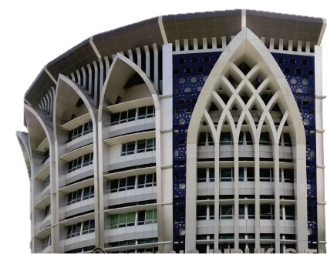
Introduction
Teachers' attention has been drawn to the topic of learning models and independence as a result of the global Covid-19 outbreak
Learning models can be one of the social factors that interact to establish, design, and guide the lives of future intelligent, creative, innovative, and independent students
In the era of the Covid-19 pandemic, a solid commitment by teachers in learning mathematics is needed to prepare students to become independent, both from the teachers themselves and from policymakers

Slide 3
Introduction
Mathematics learning in the era of the covid-19 pandemic will be of high quality through a practical combination of action and reflection
To realize such learning, alternative solutions that can be offered are "collaborative-based innovations in learning mathematics in the era of the Covid-19 pandemic".
To realize such learning, alternative solutions that can be offered are "collaborative-based innovations in learning mathematics in the era of the Covid-19 pandemic".

Slide 4
Purpose
To develop an effective collaborative-based model for managing mathematics learning in the era of the covid-19 pandemic to increase learning output.
To describe learning mathematics in the era of the covid-19 pandemic, which is collaborative-based, and
To describe habituation of independent students.

Slide 5
Methods
Research Design
qualitative
ethnographic
Subjects
School principals, mathematics teachers, and grade IX students of SMP Negeri 1 Colomadu Karanganyar, Central Java, Indonesia
Data Collection
observation techniques and field notes
Interviews
documentation
Data Validity
triangulation from sources and techniques
Data Analysis
carried out inductively

Slide 6
Results & Discussion
Collaborative Mathematics Learning Model for The Covid-19 Pandemic Era
Stages of collaboration-based mathematical learning
Paradigm of collaboration-based mathematical learning
The Great Task
to improve the character and
The Success Key
Refelection in action and retroactive reflection
The Responsibility
shared between teachers and parents
to build the children's character
The Implication
create intelligent, creative, innovative, and entrepreneurial lives
Dialogue
Introduction
conditioning, apperception, motivation, delivery of learning objectives and processes
Main Activities
integrating scientific approaches, strategies, methods, and learning media
Closing
reflection, conclusion, posttest, and follow-up

Slide 7
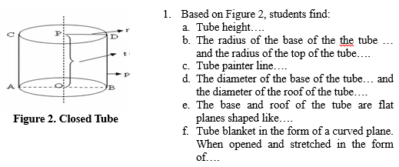
Results & Discussion
Example of reflection
Reflection in learning mathematics in the era of the Covid-19 pandemic based on collaboration
which ones are appropriate
which ones are not appropriate
what causes have not been implemented
alternative following action to be appropriate
Reflection
Dialogue
functioned as an awareness of students who are silent so that students take action
a democratic process and respects student experience

Slide 8
Results & Discussion
Assessment in learning mathematics on collaboration
carried out authentically
associated with character quality, mastery of numeracy literacy, and developing higher-order thinking processes
Worksheets in collaboration-based mathematics learning
to familiarize students with independent study
designed to find concepts, joint problem solving and problem-solving independently
includes concept development, controlled exercises, and independent exercises

Slide 9
Results & Discussion
Independent Student Habituation
before learning, the teacher guides in familiarizing students with finding mathematical concepts independently with the help of worksheets
collaboration-based learning in the era of the Covid-19 pandemic was carried out by accustoming students to think independently and regulate themselves rather than relying on others
the collaborative-based learning of mathematics in the Covid-19 pandemic era emphasizes the importance of preserving human existence, in the sense of helping humans to be more humanized, more cultured, as whole human beings to develop. According to the reflection results, the learning process is continuously improved to balance the individuality aspect to the social aspect as a community together.

Slide 10
Conclusion
a new paradigm in collaboration-based mathematics learning:
"students actively construct meaning – teachers as facilitators, while students discover concepts – teachers support problem-solving."
The management model was carried out through three stages of introduction, core activity, and closing; with five conditions: 1) implementation of learning method; 2) The management of study groups and media; 3) The management of teaching materials; 4) Multi-directional interaction management; and 5) Management of authentic assessment.
In preparing independent students, mathematics teachers are required to be wise and challenging students, and also empower, enable, and build students' abilities.

Slide 11
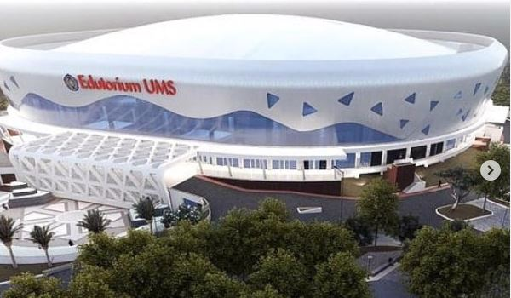
T
e r i m a k a s i h

